Slide 1


MAJOR PROJECT SEMINAR
ON
“IOT BASED ADVANCED 4 FEET REAL TIME LED SCROLLING LED DISPLAY”
BY
P MOURYA DEEPAK
V REEMA RANI
G AMARNATH
MENTOR: Mr. A. BALA RAJU M.E., B.TECH, PH.D.*
DEPARTMENT OF ELECTRONICS AND COMMUNICATION ENGINEERING

Slide 2
AIM OF THE PROJECT
The aim of the project is to create an advanced LED scrolling display using IoT technology that can provide real-time information to users. The 4 feet dimension of the display is designed to enable it to be easily visible from a distance, making it an ideal tool for dissemination of information to a large audience. The project will incorporate features such as real-time connectivity and the ability to display a wide range of information, including different languages, time, and emojis. Through this project, users will have access to important and timely information that can aid decision-making and improve overall productivity.

Slide 3
ABSTRACT
The project aims in designing a digital notice board with display on Scrolling LED display using a Wi-Fi technology. We can implement this technology in schools, colleges, banks etc.... After accessing every message, it automatically resets, and it displays the latest message on LED display. This project consists of an onboard computer, which consists of number of input and output ports. These onboard computers are commonly termed as micro controllers. The input and output port of the controller are interfaced with different input and output modules depending on the requirements. In other words, micro controller acts as a communication medium for all the modules involved in the project.
In this project we make use of Wi-Fi, Micro Controller, and a Scrolling LED (4ft x ½ ft.) display. User can send the messages to the Wi-Fi controller. The Wi-fi controller automatically reads the message and displays on Scrolling LED display. This process continues for every new message we send to it. The previous message will be automatically overridden by new message and buzzer alert is given for every new message. Finally, this project displays the messages on the LED scrolling display with many features and in different languages. This can be used to display the message in HOD cabin and to make the information shared with others.

Slide 4
INTRODUCTION
The project aims in designing a digital notice board with display on Scrolling LED display using a Wi-Fi technology. We can implement this technology in schools, colleges, banks etc.… After accessing every message, it automatically resets, and it displays the latest message on LED display.
This project consists of an onboard computer, which consists of number of input and output ports. These onboard computers are commonly termed as micro controllers. The input and output port of the controller are interfaced with different input and output modules depending on the requirements. In other words, micro controller acts as a communication medium for all the modules involved in the project.
In this project we make use of a Wi-Fi module, Micro Controller and a Scrolling LED (4 ft x ½ ft.) display. The microcontroller automatically reads the message and displays on Scrolling LED display. This process continues for every new message we send to it. The previous message will be automatically overridden by new message.

Slide 5
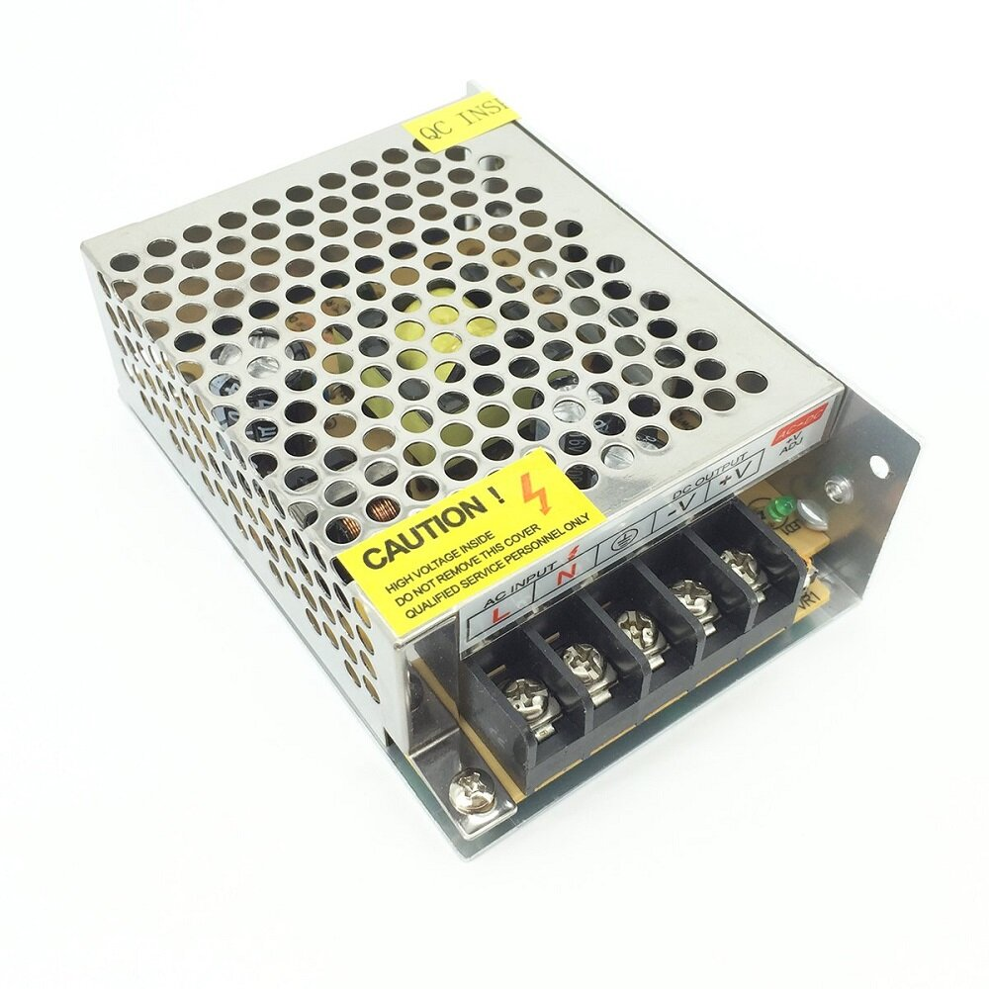
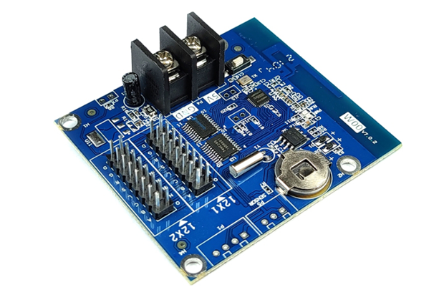
COMPONENTS
5V Switch Mode Power Supply (SMPS)
LED DISPLAY BOARD
SINGLE COLOUR WI-FI CONTROL CARD
Connecting Wires
Mother Board with PIC16F877A MicroController
Any device with LED ART App in it
ESP8266 MicroProcessor

Slide 6
BLOCK DIAGRAM
WIFI BASED DIGITAL NOTICE BOARD WITH DISPLAY ON SCROLLING LED DISPLAY
Regulated Power Supply
Wi-Fi Module
Scrolling LED Display
MICRO CONTROLLER
RESET
ESP8266 Microprocessor
Crystal Oscillator
LED Indicators

Slide 7
METHODOLOGY
SWITCHING ON THE KIT
OPEN SETTINGS ON THE PHONE AND ENABLE WIFI
OPEN LED ART APP AND ADD NEW DEVICE
ENTER THE DATA TO DISPLAY ON THE LED BOARD
CONNECT THE WIFI ON PROGRAM LIST
ADD A NEW PROGRAM IN THE APP
SELECTING VARIOUS FORMS AND SETTINGS FOR DISPLAYING DATA
LED BOARD DISPLAYS THE DATA

Slide 8
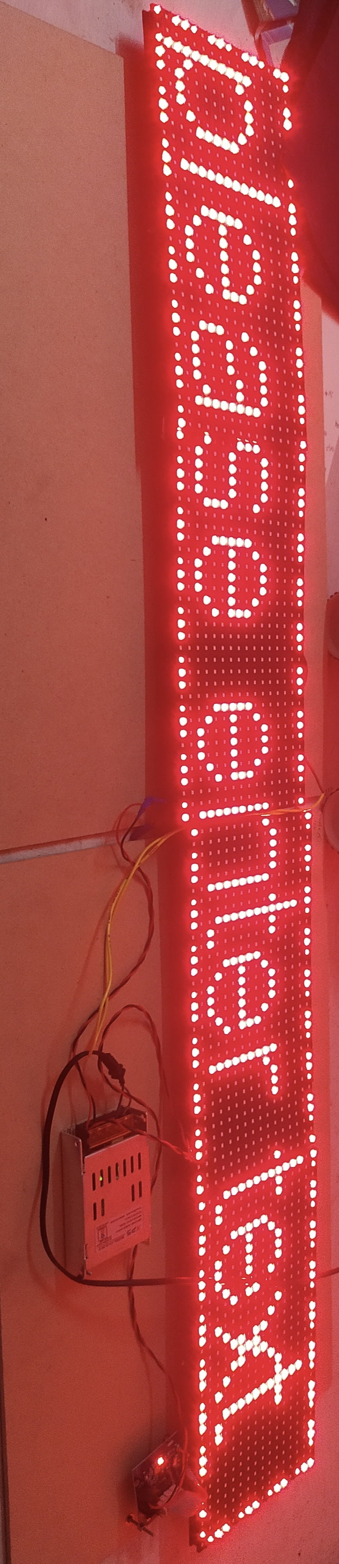
RESULTS
Fig 1 : SCROLLING LED DISPLAY BOARD

Slide 9
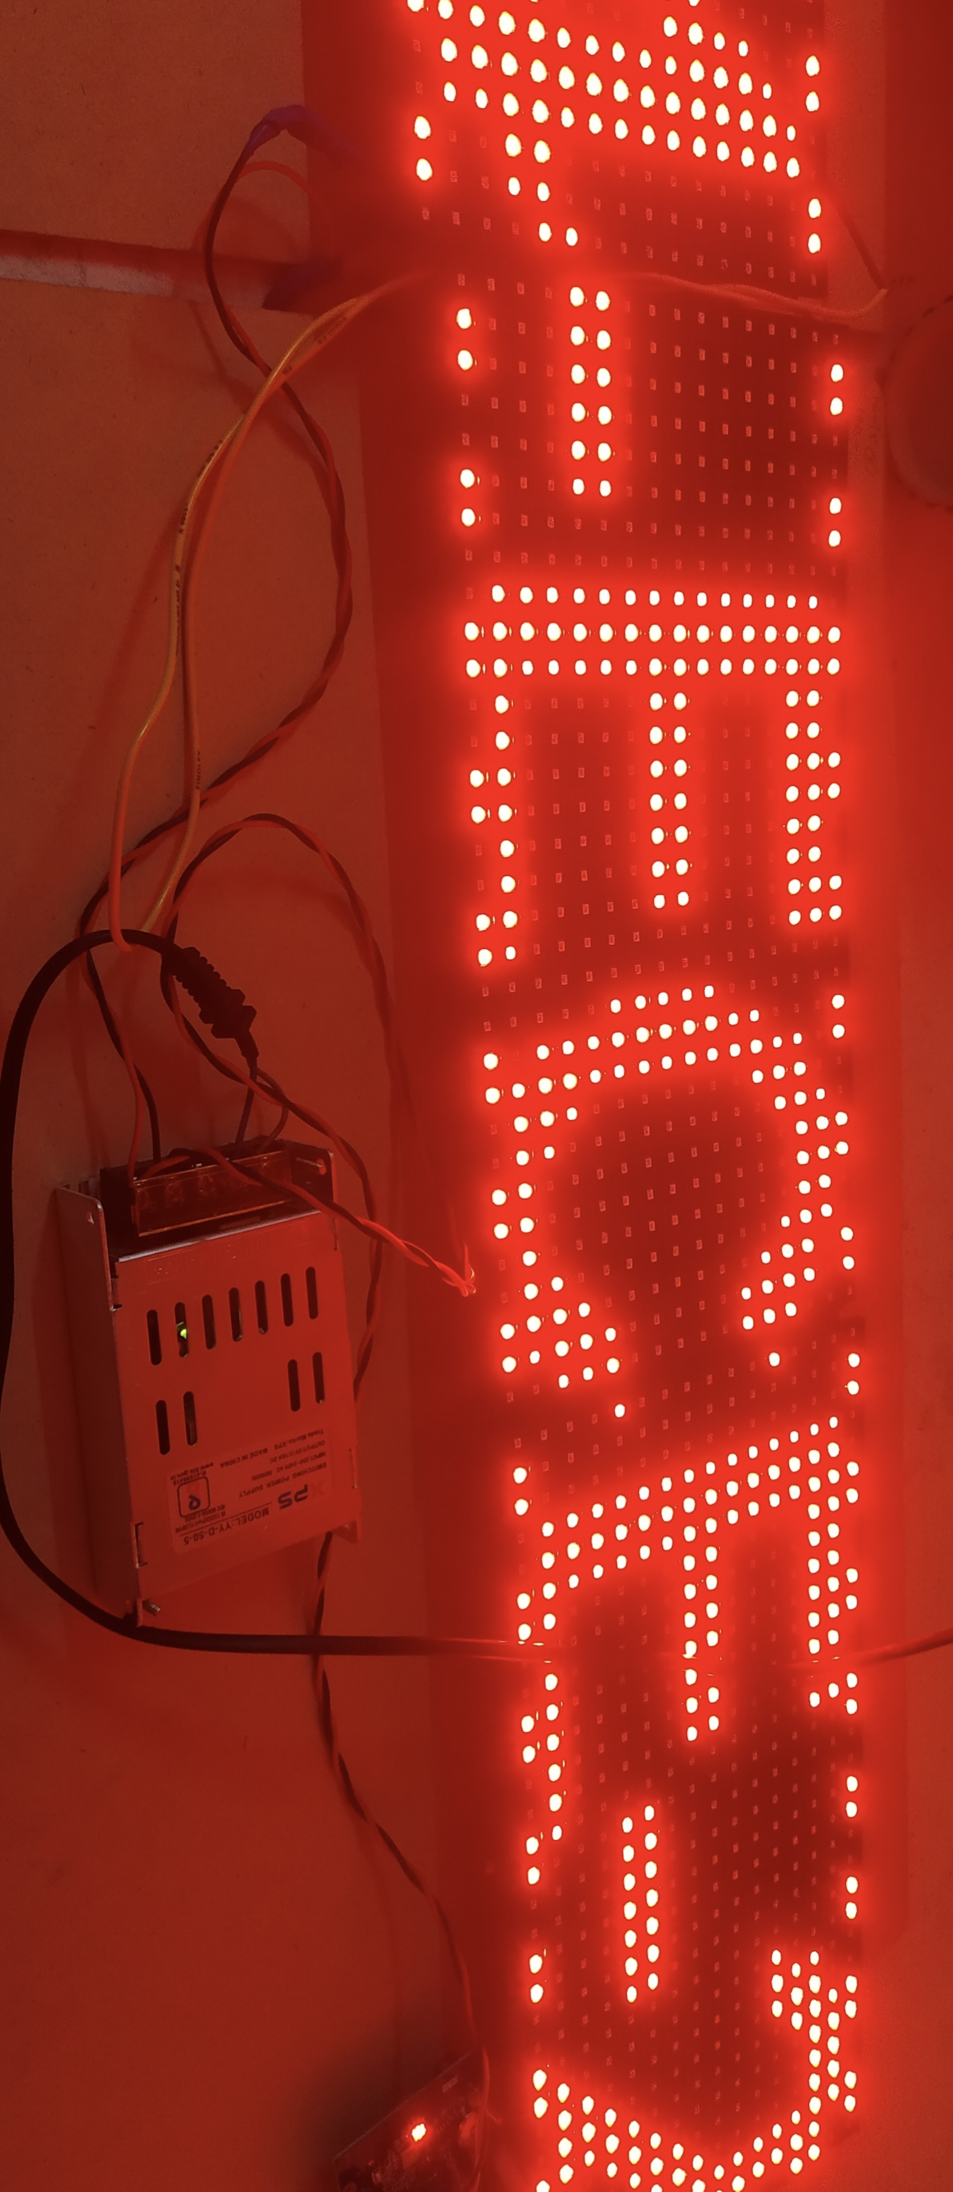
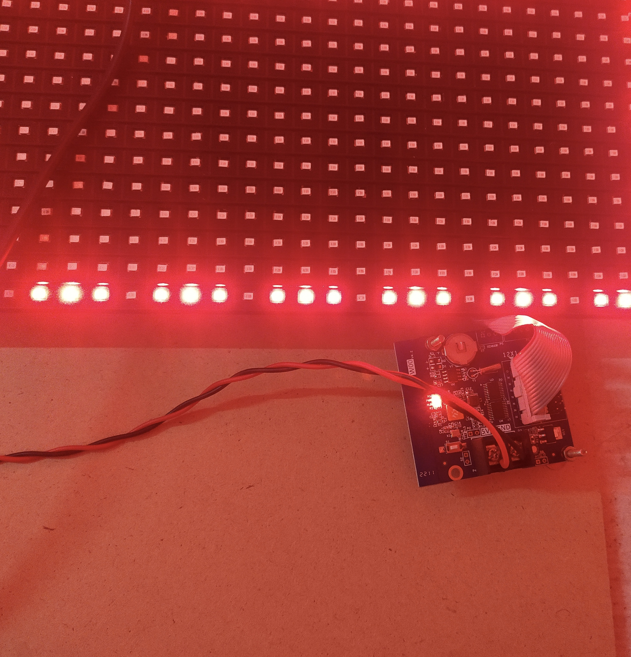
RESULTS
Fig 2 :Data received from the LED ART app and displayed on the
Board using wi-fi module
Fig 3 :Wi-fi MODULE

Slide 10
APPLICATIONS
Information Display of Airport Flight Dynamic State.
Information Display of the Guidance for Guests at Ports and Stations
Information Display of Sports Venues.
Information Display of Road Traffic
Bars
Building Curtain Wall
Exhibition
Performance and Assembly
Using LED Display to Promote Business
Community Media

Slide 11
CONCLUSION
In conclusion, the IOT based advanced 4 feet real-time LED scrolling display is an innovative and highly functional project that utilizes the power of the internet of things to create an interactive and eye-catching LED display. With its impressive 4*1/2 feet dimension, the display is large enough to attract attention from a distance and provide real-time updates on various types of information. This project has the potential to be used in various settings such as transportation hubs, shopping malls, and educational institutions to inform and engage audiences in new and exciting ways.

Slide 12
REFERENCES
Prachi U. Ketkar, Kunal P. Tayade, Akash P. kulakarni, Rajkishor M. Tugnayat "GSM Mobile Phone based LED Scrolling Message Display System" International Journal of Scientific Engineering and Technology, Volume:2. Issue-3, PP: 149-155, ISSN:2277- 1581, 1st April 2013.
Anuradha Mujamdar, Vaishali Niranjane, Deepika Sagane "Scrolling LED Display using Wireless transmission" International Journal of Scientific Engineering and Technology, Volume:2, Issue-1, ISSN:2321-9939.
Bhawna Saini, Rachna Devi, Shilpi Dhankhar, Mohammad-ziaul-Haque, Jagandeep Kaur "Smart LED Display Boards" International Journal of Electronic and Electrical Engineering. ISSN 0974-2174 Volume 7, Number 10 (2014), pp. 1057-1067
Htet Htet Thit San, Chaw Myat Nwe and Hla Myo Tun "Implementation of PIC Based LED Displays" International Journal of Scientific Engineering and Technology, Volume:3 ISSN: 2277-1956, 191-198
Januce Gillespie Mazidi, Rolin D. McKinlay, Muhammad Ali Mazidi 'The 8051 Microcontroller and System'.

Slide 13
THANK YOU

